Slide 1


Day: 15 Reviewing Intercompany Matching and Reconciliation
Day: 16 Implementing Intercompany and Matrix Eliminations
Review Intercompany Matching and Reconciliation
Configure Payable and Receivable Intercompany Eliminations

Slide 2

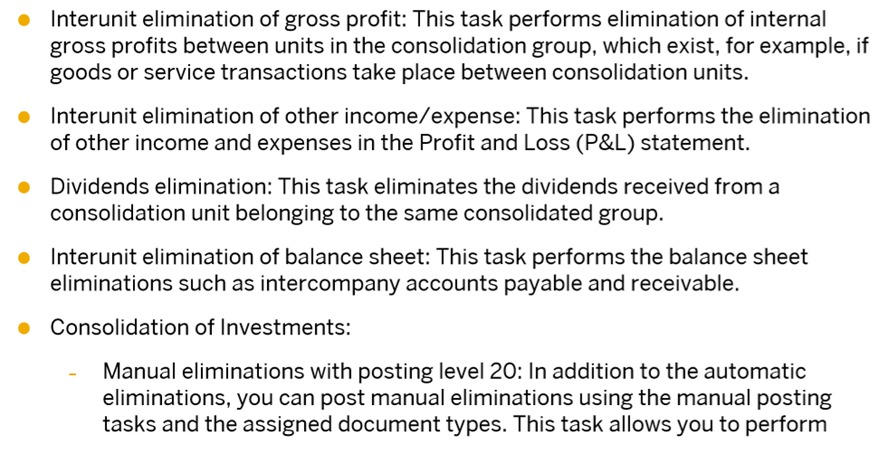
Consolidation Monitor Activities

Slide 3
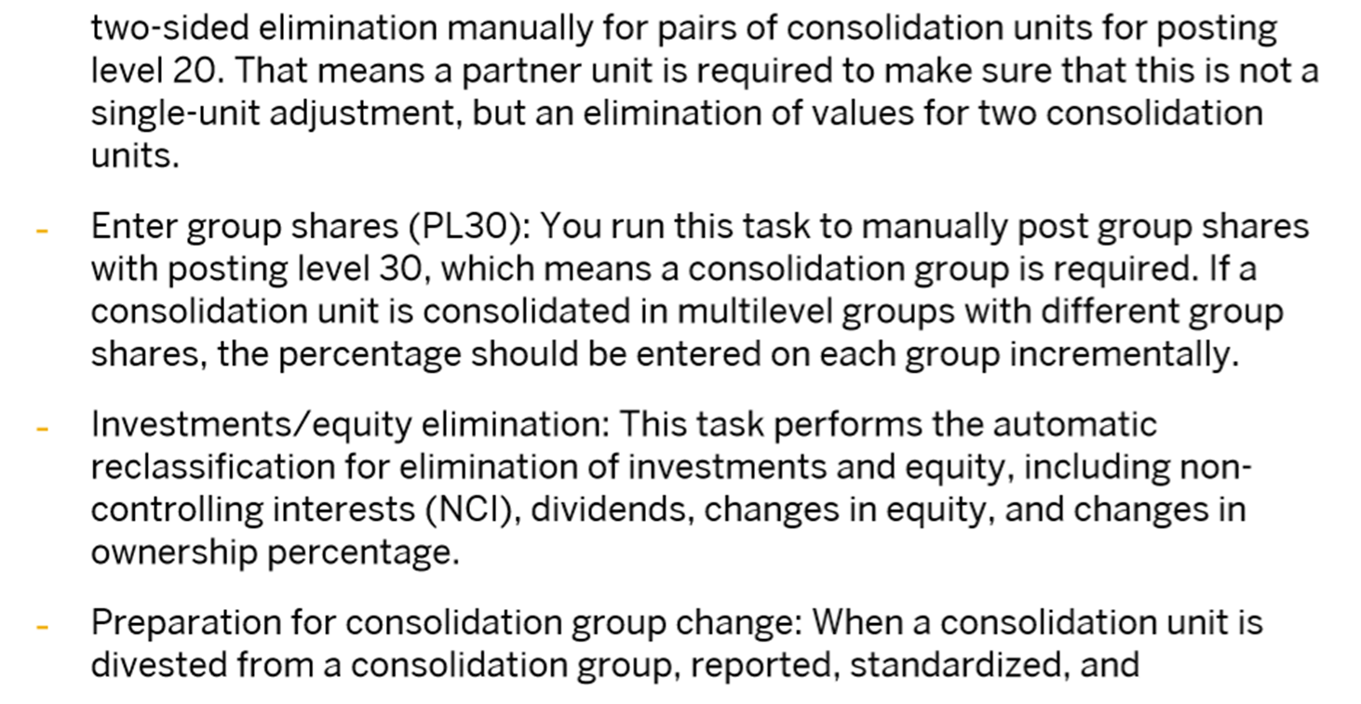

Slide 4
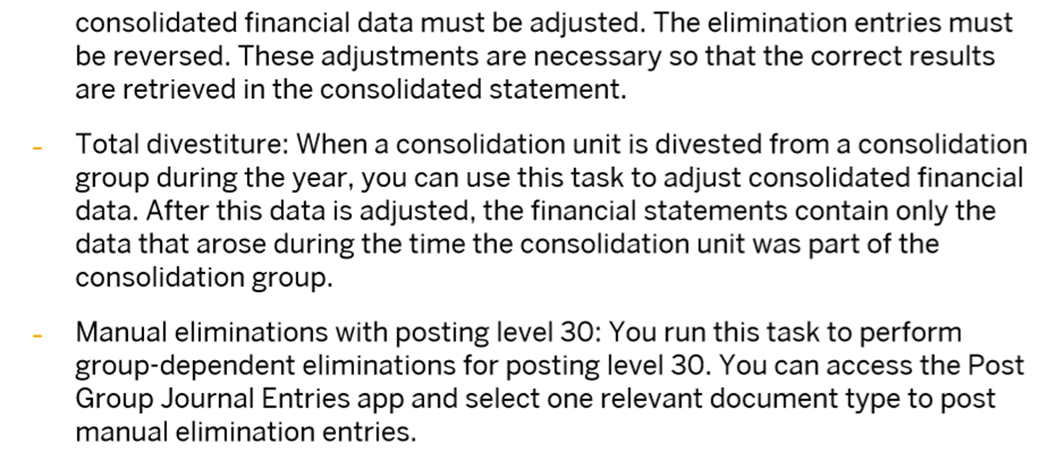
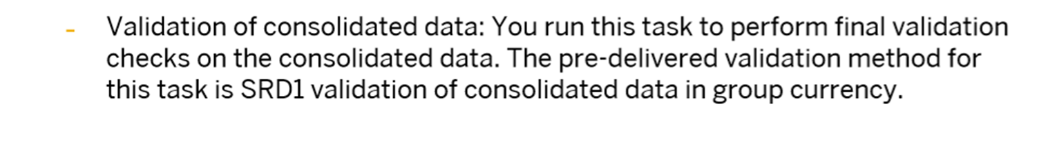

Slide 5
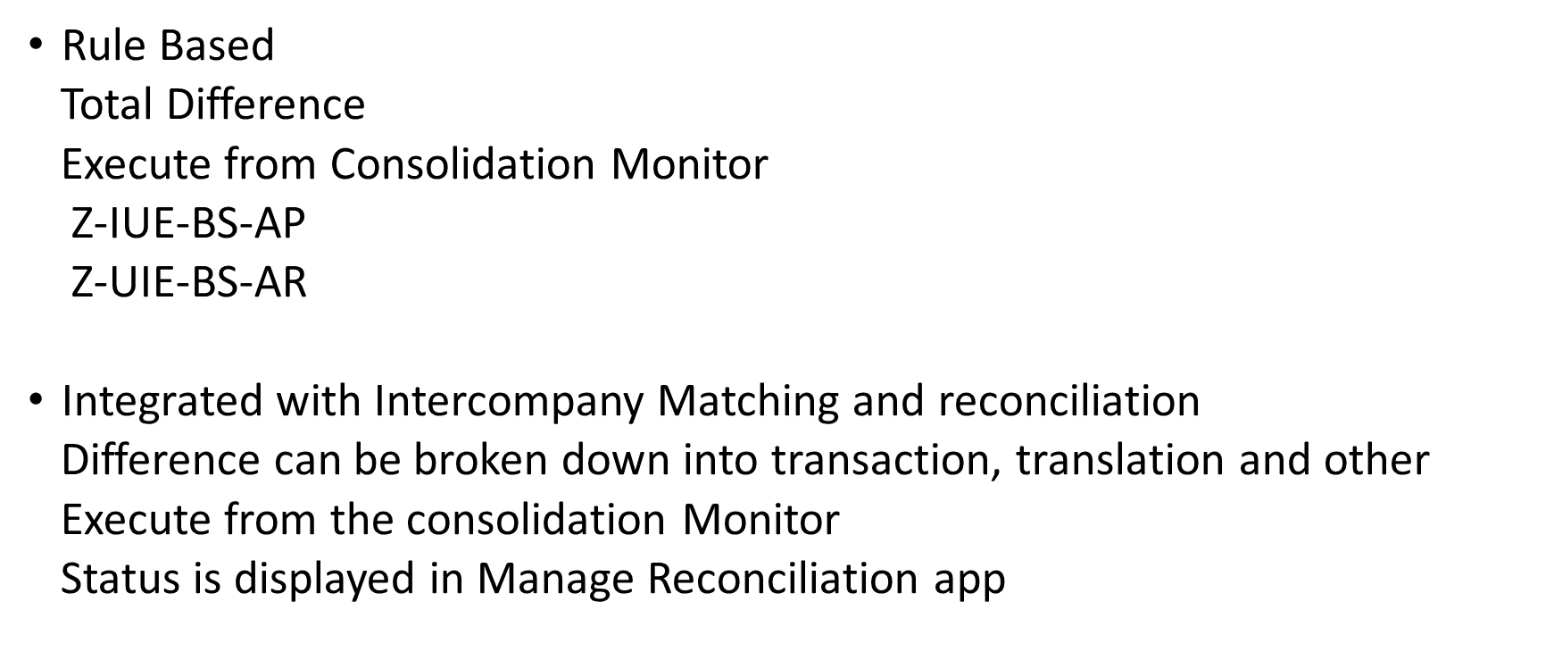
Intercompany Elimination

Slide 6
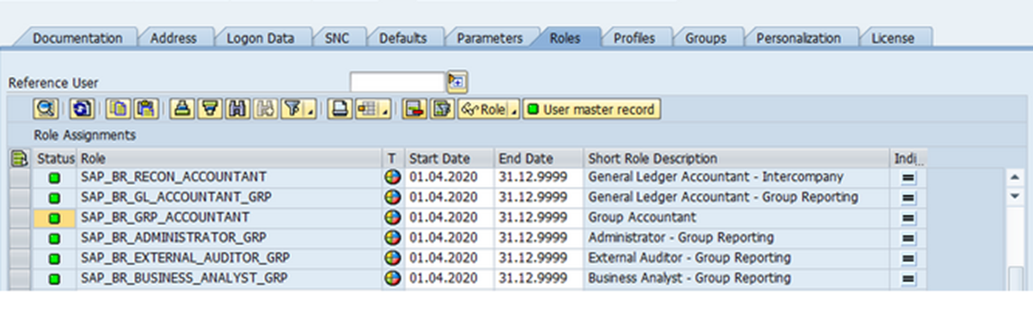

Slide 7
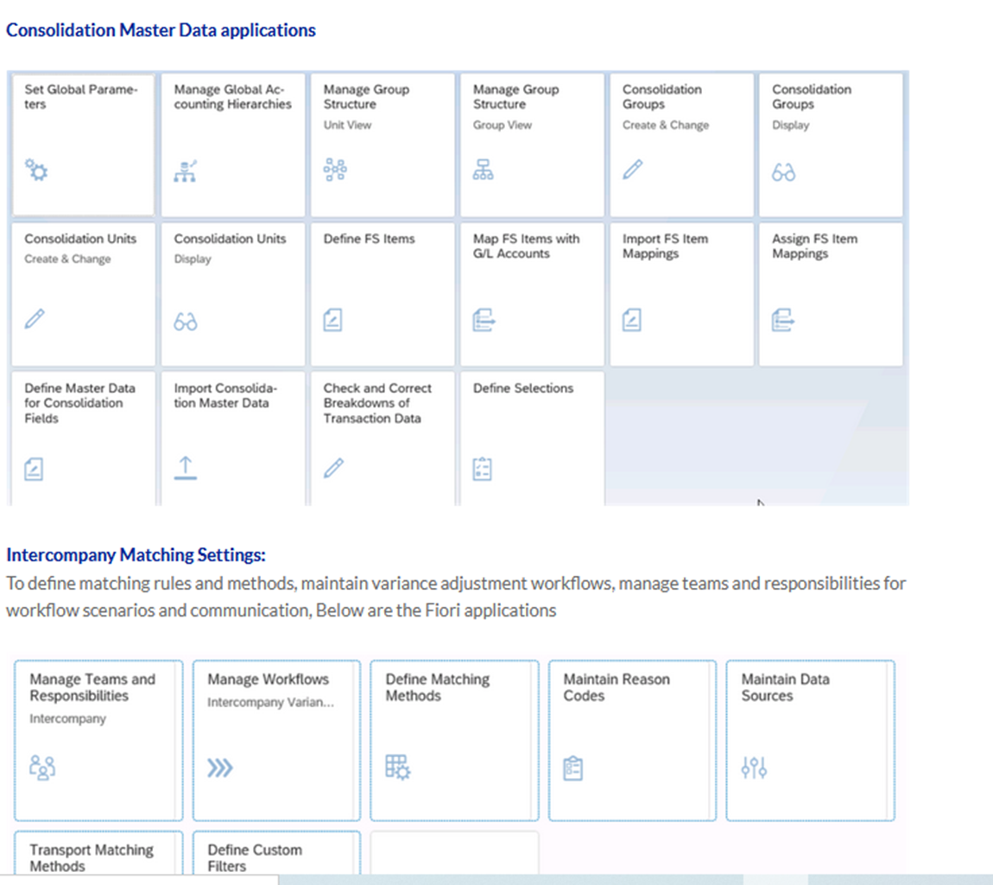

Slide 8
